Slide 1
Linear
Classifier
geometric
Linear
Regression
CHAID
Poisson
Regression
Panel
Regression
Simultaneous
Equations
Nearest
Neighbor
Decision
Trees
Logistic
Regression
Multinomial
Logit
Probit
Hierarchical
Clustering
RFM
Survival
Modeling
K-means
Rules
Affinity
Associations
SVM
Latent
Class
Analysis
Discriminate
Analysis
probabilistic
Gauss
Mixture
Model
Naïve
Bayes
grading
grouping

Slide 2
Segmentation:
Tools and Techniques

Slide 3
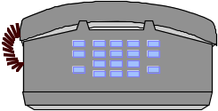






What is Segmentation?
SEGMENTATION ALGORITHM

Slide 4
WHY GO
Beyond
RFM?

Slide 5

Why Go Beyond RFM?
WHAT IS RFM?
Definition, put into place to provide immediate return
RFM works to find those most engaged
WHAT IS BEHAVIORAL SEGMENTATION?
Definition, put into place to enhance
BS works to find the different sensitivities of each group

Slide 6
REVENUE
These variables tend to
be used in designing
RFM
METRICS FROM FIRM’S POV
RESULTS
margin
growth
LTV
These variables tend to
be used in designing
behavioral segments
METRICS FROM CUSTOMER’S POV
PURCHASES
Product
Penetration
BEHAVIORS
#VISITS
% Transactions
usage
responses
engagement
Engagement variables tend to
be used in designing
RFM
METRICS FROM FIRM’S POV
Share of wallet
VELOCITY
SECONDARY
CAUSES
SATISFACTION
Loyalty
Courtesy
price
lifestyle
ATTITUDES
Channel
preference
searching
NEED
AROUSAL
tastes and
preferences
PRIMARY
CAUSES
promotions
benefits

Slide 7

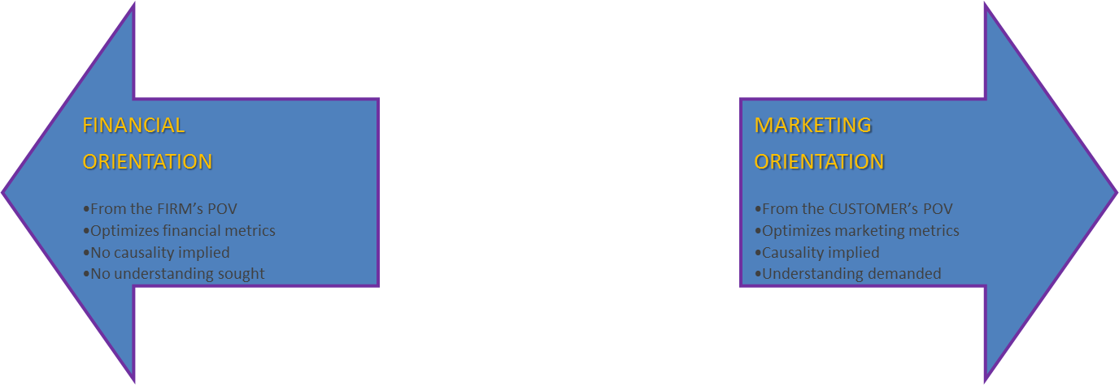
Is RFM Really an Option?
RFM is not about marketing, but finance
RFM is not about the customer, but the firm
Any marketing strategy devolves into only migration: moving customers from the “bad” tier into the “good” tier
RFM does not try to understand the rationale behind each value tier: RFM members constantly change value tiers

Slide 8
GENERAL
Segmentation
TECHNIQUES

Slide 9
A PRIORI /
BUSINESS RULES

Slide 10
RFM

Slide 11

What is RFM?
RFM is a fifty-year old algorithm invented when databases first became common
Finance demanded immediate ROI on such an (expensive) investment
The RFM process: sort the database by the three metrics (Recency, Frequency and Monetary)
ADVANTAGES
Very simple to operate, very simple to explain, very simple to understand, very likely to target (at the most recent point in time) those customers of most value to the firm
RFM will find those most recently engaged
DISADVANTAGES
As such, RFM is not customer-centric, it is firm-centric
RFM is not a marketing view, but a financial view
RFM will give no clue as to why a customer is in a particular tier (via price, product, channel)
Since every time a customer purchases, or every month that goes by, a customer potentially changes RFM tier, no real learning about a firm's market takes place

Slide 12
CHAID / CART

Slide 13

CHAID
Advantages
  Easy and intuitive way of identifying relationships between variables
  Easily understandable
  Nice graphical representation of solution
  Flexible with data: does not require the statistical assumption of multivariate normality, dependent variables and predictors can be categorical or continuous, missing values can be included in analysis as a separate level
Disadvantages
  CHAID is not a segmentation (inter-relationship) algorithm, it is a dependent variable algorithm
    CHAID is not designed to maximally separate into homogeneous within and heterogeneous between
    CHAID is not simultaneously multivariate—it tests all variables one at a time based on the X²
  Limited hindsight. CHAID cannot go back after its worked out all the groupings and splits and re-evaluate the higher level variables in light of what its learned about splits on other variables lower in the tree. There is no correction or updating
  Potential for large and bushy trees, which are difficult to interpret
  No diagnostics to guide a better solution, information on “fit”, impact of an independent variable on the dependent variable, etc.
  CHAID might be a better data exploration tool than a segmentation tool

Slide 14
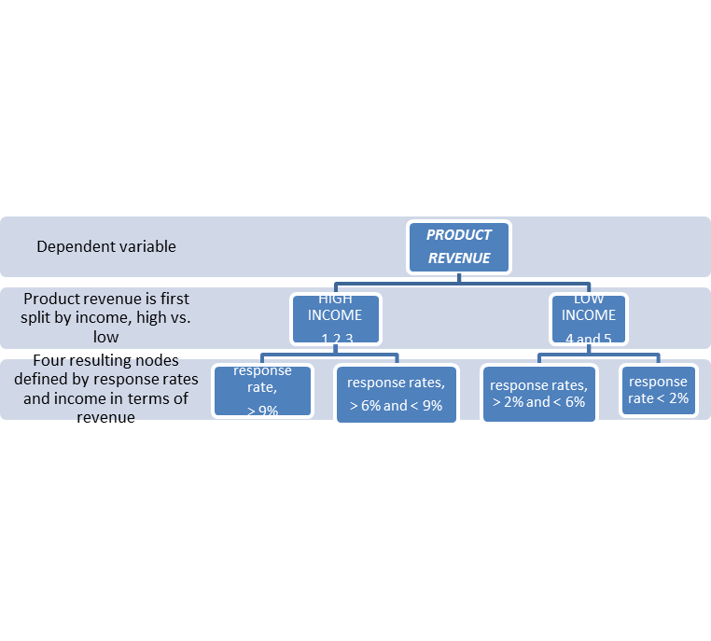
What is CHAID?
CHAID (Chi-Square Automatic Interaction Detection) is a relatively simple modeling technique
CHAID optimizes the prediction of a target variable by choosing variables with the strongest relationship to the target and then splitting the variables into groups. CHAID output comes in the form of a decision tree
  CHAID maximizes prediction by combining levels of a categorical variable or making discrete a continuous variable
  Predictor variables can be categorical or continuous
  For a continuous target measures, CHAID uses a F-statistic and for categorical CHAID uses a χ² to determine the optimal set of variables and the optimal split for each variable

Slide 15
HIERARCHICAL CLUSTERING

Slide 16
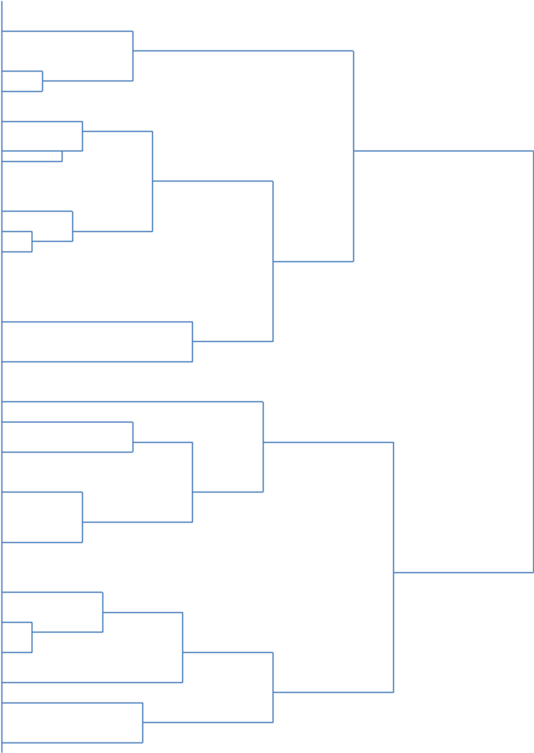
111
34
56
134
181
12
2
78
123
17
178
3
56
115
32
65
128
9
36
76
179
23

Slide 17
K-MEANS

Slide 18
What is K-Means?
K-means is a very common technique. K-means (partitioning / iterative clustering) is not a tree-like structure, and it is not statistical, but mathematical
The general algorithm is:
1) Choose the number of clusters to find and choose which variables to use in defining the clusters—note that variables define the clusters
2) Select the first customer that has all clustering variables populated and designate this as cluster 1
3) Go to the next customer that has all clustering variables populated and calculate the mean value of all the clustering variables in terms of the squared root of Euclidean distance and see if the second customer is “far enough” away from the first customer to make a new cluster. If so, call this cluster 2
4) Go to the next customer and, if far enough away from the above centroids, and if the number of found clusters has not been reached, then make another cluster. This continues until all clusters are found and all customers are assigned
ADVANTAGES
K-means is very fast and can operate on a large data set. It is simple to use and easy to understand
DISADVANTAGES
The arbitrariness of very critical algorithm design criteria makes this technique flawed. In practice, a clustering solution is run many times, with different clustering variables and different number of clusters to be found until the output seems “acceptable”. This can be VERY time consuming and is often only arbitrary
A secondary technique can help with the final analysis, in terms of whether the clustering variables actually predict the clusters, and that is called discriminate analysis. This at least tells if the variables discriminate between the clusters, but it cannot tell if there was a better combination of variables and it cannot tell if the right number of clusters has been found, etc.
K-means tends to produce clusters essentially the same size
The clusters might not be very distinct from each other

Slide 19
K-Means Applications
Use Notes
  Affected by the variance of the variables. Variables with larger variances will dominate the solution. Cure: Standardize the variables
  Affected by outliers and variables with highly skewed distributions. Cure: Get rid of outliers and transform variables to approximate normality
  Cannot handle dichotomous variables because these variables can neither be transformed to normality or be standardized. They dominate the solution and form their own cluster. Cure: None, Don’t include them
  Affected by the initial centroid choice. Bad initial centroid choice can lead to suboptimal partitioning. Cure: Obtain better solutions when you cluster the clusters. Generate a solution with a 100 clusters. Keep clusters with a minimal of 100 observations. Then cluster the centroids of those clusters
  Must run separate solutions with different cluster number restrictions to determine best solution

Slide 20
How Many Segments and What Solution is Best?
CCC is not widely used in the industry but common in academics
1) Run K-means with same variables for segment solutions N + N+1
until CCC maximizes and then drops (e.g. scree plot).
2) Use that number of segments.
For optimal solution use discriminate analysis
until ln Det (covar within / between) is closest to 0

Slide 21
SVM

Slide 22

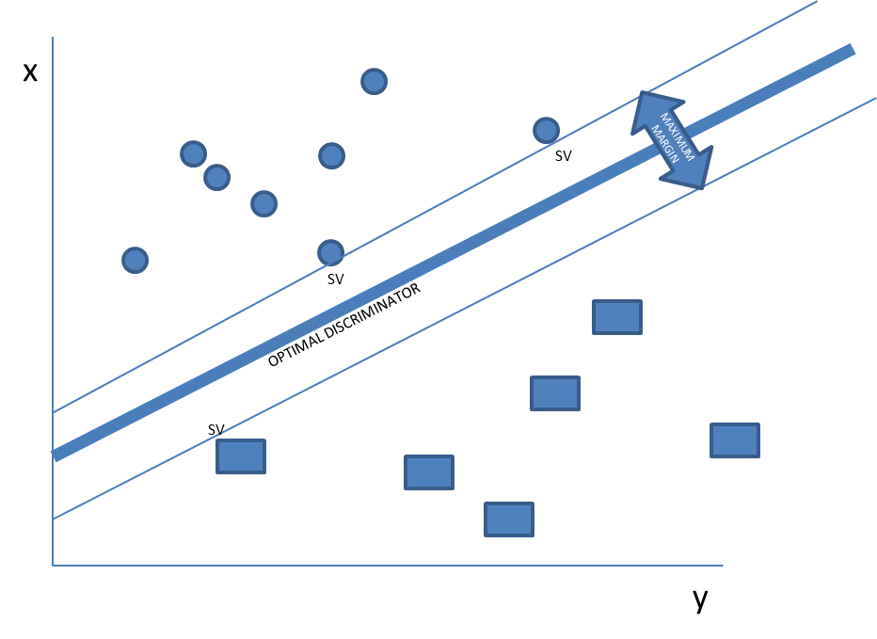
What is Support Vector Machine?
SVM is an optimization technique.
It is typically used as a mathematic classifier.
The idea is to find the ‘support vectors’, those points (rotated or not) that define the
optimal line (or hyper-line) used via Lagrange multipliers to maximally discriminate.
ADVANTAGES
Can easily incorporate non-linear
hyper planes
DISADVANTAGES
Is ultimately mathematics, not
probabilistic

Slide 23
LATENT CLASS

Slide 24
What is Latent Class Analysis?
Latent Class analysis is a computationally complex and sophisticated procedure. It is a categorical analogue of factor analysis but computationally is more similar to log linear analysis
  Latent Class asserts that the associations between the variables are completely explained by an unobserved (latent) categorical variable. In other words, the variables are conditionally independent given the latent variable
  This assumption imposes a restriction on the joint distribution of the observed variables
  Samples sizes need to be sufficiently large to estimate the different combinations formed by the variables
  Latent Class analysis calculates, for each variable combination, the probability of belonging to each segment. An observation with a particular variable combination is assigned to the segment with the highest probability
WHAT NUMBER, AND SIZE, OF SEGMENTS MAXIMIZE THE PROBABILITY OF OBTAINING THE SCORES ON THE SEGMENTING VARIABLES?
USING THE ABOVE SEGMENTING VARIABLES, HOW WELL DOES THE MODEL FIT (GIVEN THE NUMBER AND SIZE OF THE SEGMENTS) IN TERMS OF PRIOR PROBABILITIES?

Slide 25



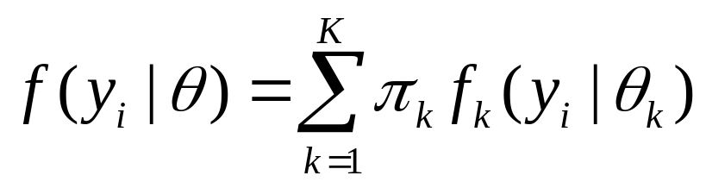
How Does LCA Work?
STEP 1: Classify customers into segments and calculate probability of observing the scores on the segmenting variables
STEP 2: Reclassify based on an improvement algorithm (Expectation Maximization)
STEP 3 – STEP N: Continually reclassify until best solution is found, given:
=>optimal number of segments (of certain sizes) that maximize the probability of observing the scores on the segmenting variables
  ys are segmenting variables
  y_{i} is a customer’s scores on a set of segmenting variables
  K is the number of segments
  π_{k} denotes the size of segment k
  “The distribution of y_{i}, given the model parameters Θ, and f( y_{i} |Θ) is assumed to be a mixture of class-specific densities, f_{k}( y_{i} |Θ_{k})”

Slide 26

Latent Class
Advantages
  Excellent for categorical data and variables that are not normally distributed, invariant to outliers or differences in variance, fairly apparent cluster characteristics
  Finds optimal number of segments
  Diagnoses significant variables to include
  Scores each customer with probability of belonging to each segment
Disadvantages
  Need to make discrete continuous variables. Lose important information
  Can be computationally intensive. Number of variable combinations grow exponentially with the addition of each variable and with the addition of levels to a variable
  Not part of standard statistical packages
Clustering
Techniques

Slide 27

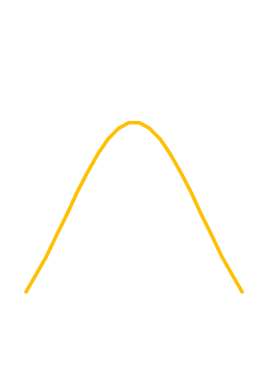

Why Is LCA Superior?
Example of an output file. P(1) – P(8) are segment probabilities. LC is segment assignment based on the maximum probability
P(1) P(2) P(3) P(4) P(5) LC
.1722 .6120 .0001 .2013 .0143 2
.0000 .0000 .0044 .4598 .5384 5
.1398 .0000 .0001 .8558 .0049 4
Multivariable
Includes more than one dimension
Multivariate
Includes more than one dimension simultaneously
Probabilistic
Is a statistical model based on maximum likelihood
Bayesian
Allows for prior probabilities and is bi-directional
Simultaneous complexity
Increased dimensionality in phase space
Maximum
likelihood
A
B

Slide 28

Accuracy: LCA vs. K-Means
A contrived dataset was created with variables (Xs) having known means and variances
These distributions were applied to a set of observations (mimicking customers) and an equation used to assign these “customers” into a mathematically derived segment
EQ seg1: x1, x3, x4, x5 ….xn
EQ seg2 : x2, x3, x6, x7….xn
… … … …
EQ seg5: x4, x6, x8, x9 …xn
K-means was run against this data set and given two distinct advantages:
it was told the number of clusters was 5
it was told which variables were significant in making the clusters
LCA was not given either piece of the above information

Slide 29
Accuracy: LCA vs. K-Means
 |  | EQ | EQ | EQ | EQ | EQ |  |  |  |  |  | EQ | EQ | EQ | EQ | EQ
 |  | SEG1 | SEG2 | SEG3 | SEG4 | SEG5 |  | SIZE |  |  |  | SEG1 | SEG2 | SEG3 | SEG4 | SEG5 |  | SIZE
LCA | SEG1 | 956 | 42 | 3 | 0 | 0 | 1,001 | 32% |  | KM | SEG1 | 555 | 170 | 24 | 50 | 11 | 810 | 26%
LCA | SEG2 | 26 | 888 | 3 | 7 | 0 | 924 | 29% |  | KM | SEG2 | 151 | 577 | 26 | 136 | 12 | 902 | 29%
LCA | SEG3 | 16 | 10 | 499 | 84 | 16 | 625 | 20% |  | KM | SEG3 | 77 | 79 | 364 | 81 | 3 | 604 | 19%
LCA | SEG4 | 11 | 10 | 15 | 433 | 5 | 474 | 15% |  | KM | SEG4 | 99 | 56 | 92 | 183 | 19 | 449 | 14%
LCA | SEG5 | 6 | 10 | 37 | 0 | 73 | 126 | 4% |  | KM | SEG5 | 133 | 78 | 51 | 74 | 49 | 385 | 12%
 |  | 1,015 | 960 | 557 | 524 | 94 | 3,150 |  |  |  |  | 1,015 | 960 | 557 | 524 | 94 | 3,150
 |  | EQ | EQ | EQ | EQ | EQ |  |  |  |  |  | EQ | EQ | EQ | EQ | EQ
 |  | SEG1 | SEG2 | SEG3 | SEG4 | SEG5 |  |  |  |  |  | SEG1 | SEG2 | SEG3 | SEG4 | SEG5
LCA | SEG1 | 94% | 4% | 1% | 0% | 0% |  |  |  | KM | SEG1 | 55% | 18% | 4% | 10% | 12%
LCA | SEG2 | 3% | 93% | 1% | 1% | 0% |  |  |  | KM | SEG2 | 15% | 60% | 5% | 26% | 13%
LCA | SEG3 | 2% | 1% | 90% | 16% | 17% |  |  |  | KM | SEG3 | 8% | 8% | 65% | 15% | 3%
LCA | SEG4 | 1% | 1% | 3% | 83% | 5% |  |  |  | KM | SEG4 | 10% | 6% | 17% | 35% | 20%
LCA | SEG5 | 1% | 1% | 7% | 0% | 78% |  |  |  | KM | SEG5 | 13% | 8% | 9% | 14% | 52%
 |  |  |  |  |  |  | 91% |  |  |  |  |  |  |  |  |  | 55%
Better segmentation means better strategy

Slide 30
LCA OUTPUT | SEGMENT 1 | SEGMENT 2 | SEGMENT 3 | SEGMENT 4 | SEGMENT 5 | SEGMENT 6 | hi/low
% OF MARKET | 30% | 24% | 19% | 15% | 9% | 3% | 12
% OF REVENUE | 32% | 39% | 9% | 17% | 2% | 0% | 81.44
NUM TOTAL PURCH | 14.49 | 25.64 | 8.88 | 18.17 | 7.95 | 9.65 | 3.23
REV DT PURCH | 3,150 | 4,730 | 999 | 2,592 | 352 | 81 | 58.4
REV NB PURCH | 2,320 | 720 | 680 | 1,152 | 630 | 168 | 13.81
REV TOTAL PURCH | 6,281 | 9,786 | 2,742 | 6,811 | 1,393 | 1,154 | 8.48
NUMBER DM SENT | 13.5 | 9.1 | 19.5 | 5.6 | 6.8 | 9.5 | 3.48
NUMBER EM SENT | 15.9 | 17.8 | 9.1 | 12.9 | 15.5 | 12.8 | 1.96
NUMBER EM OPEN | 1.4 | 3.2 | 0.4 | 4.5 | 1.7 | 2.6 | 12.4
NUMBER EM CLICK | 0.1 | 0.4 | 0 | 2.3 | 0.3 | 0.2 | 124.04
NUMBER PROD PURCH CALL CENTER | 3.6 | 2.6 | 8 | 0.9 | 2 | 3.9 | 8.8
NUMBER PROD PURCH ONLINE | 10.9 | 23.1 | 0.9 | 17.3 | 6 | 5.8 | 25.99
NUM CALL CENTER PURCH | 3.6 | 2.6 | 8 | 4.5 | 3.6 | 5.8 | 3.12
EDUCATION (YEARS) | 19.1 | 12.9 | 11.8 | 17.9 | 13.8 | 13.8 | 1.62
INCOME | 185,000 | 60,000 | 45,000 | 125,000 | 15,250 | 75,000 | 12.13
Q4 PURCHASE | 25% | 70% | 83% | 14% | 15% | 41% | 5.93
TIME BET PURCH (MONTHS) | 6.5 | 3.1 | 16.5 | 4.2 | 9.4 | 15.4 | 5.32
TIME BET VISITS (WEEKS) | 3.2 | 2.1 | 9.5 | 1.9 | 3.9 | 8.5 | 5
K-MEANS OUTPUT | SEGMENT 1 | SEGMENT 2 | SEGMENT 3 | SEGMENT 4 | SEGMENT 5 | SEGMENT 6 | hi/low
% OF MARKET | 24% | 19% | 17% | 16% | 15% | 9% | 2.67
% OF REVENUE | 19% | 15% | 17% | 19% | 18% | 13% | 1.45
NUM TOTAL PURCH | 14.1 | 17.7 | 16.2 | 14.8 | 16.9 | 17.2 | 1.26
REV DT PURCH | 1,901 | 2,490 | 3,498 | 4,021 | 2,011 | 2,666 | 2.12
REV NB PURCH | 1,344 | 1,108 | 1,655 | 1,100 | 1,100 | 911 | 1.82
REV TOTAL PURCH | 4,992 | 5,006 | 6,271 | 7,509 | 7,489 | 9,200 | 1.84
NUMBER DM SENT | 10.1 | 11 | 11.2 | 12.8 | 12.9 | 15.1 | 1.5
NUMBER EM SENT | 11.9 | 15.2 | 16.4 | 15.2 | 14.9 | 15 | 1.38
NUMBER EM OPEN | 1.8 | 2.2 | 2.3 | 2.2 | 2.1 | 2.8 | 1.56
NUMBER EM CLICK | 0.61 | 0.66 | 0.54 | 0.52 | 0.51 | 0.26 | 2.54
NUMBER PROD PURCH CALL CENTER | 3.1 | 3.6 | 3.7 | 3.9 | 3.4 | 4.9 | 1.58
NUMBER PROD PURCH ONLINE | 9.1 | 10.2 | 12.4 | 17.1 | 13.5 | 13.6 | 1.88
NUM CALL CENTER PURCH | 3.5 | 3.9 | 4.9 | 4.9 | 4.9 | 4.2 | 1.4
EDUCATION (YEARS) | 16.3 | 16.4 | 15.1 | 13.1 | 15.3 | 15.5 | 1.25
INCOME | 109,655 | 109,166 | 98,066 | 98,054 | 97,112 | 88,055 | 1.25
Q4 PURCHASE | 39% | 34% | 61% | 44% | 44% | 55% | 1.79
TIME BET PURCH (MONTHS) | 6.6 | 7.5 | 7.7 | 9.1 | 8.1 | 7.9 | 1.38
TIME BET VISITS (WEEKS) | 3.8 | 4.1 | 4.5 | 4.6 | 3.5 | 4.9 | 1.4

